Slide 1
JAVA
Getting Started
by
- Vishnu Priya

Slide 2
Contents
Java Technology Phenomenon
The “HelloWorld!” Application
A closer look at “HelloWorld!”

Slide 3
Java Technology Phenomenon
About the Java Technology
What Can Java Technology Do?
How Will Java Technology Change My Life?

Slide 4
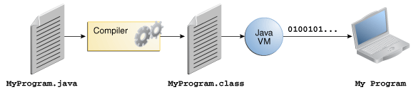
Java is a programming language

Slide 5
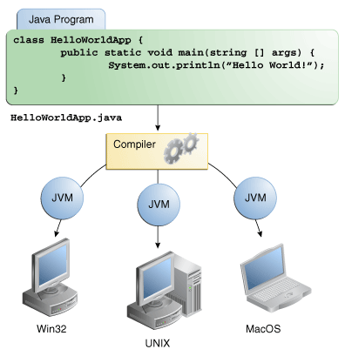
JVM

Slide 6
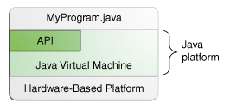
Java is a Platform

Slide 7
What can Java Technology do?
Applets
Applications
Powerful Software platform

Slide 8
How will Java technology change life?
Get started quickly
Write less code
Write better code
Develop programs more quickly
Avoid platform dependencies
Write once, run anywhere
Distribute software more easily

Slide 9
The “HelloWorld!” Application
Create a source file
Compile the source file into a .class file
Run the program

Slide 10
A closer look at “HelloWorld!”
class HelloWorldApp {
public static void main(String[] args) { System.out.println("Hello World!"); // Display the string.
}
}

Slide 11
Queries ?

Slide 12
Thank you

